Slide 1
CUDA-Accelerated Monte-Carlo for HPC Andrew Sheppard
Yeongseok Kim
System Dynamics and Applied Control Laboratory
Noise and Vibration Center plus
Korea Advanced Institute of Science and Technology

Slide 2
Monte-Carlo method
A broad class of computational algorithms
Relying on repeated random sampling to obtain numerical results
Using randomness to solve problems that might be deterministic in principle
Solving problems having probabilistic interpretations
Optimization
Numerical integration
⋯⋯

Slide 3
Monte-Carlo method
A broad class of computational algorithms
Relying on repeated random sampling to obtain numerical results
Using randomness to solve problems that might be deterministic in principle
Solving problems having probabilistic interpretations
General steps for utilizing Monte-Carlo method
Define a domain of possible inputs
Generate inputs randomly from a probability distribution over the domain
Perform a deterministic computation on the inputs
Aggregate the results
Optimization
Numerical integration
⋯⋯

Slide 4
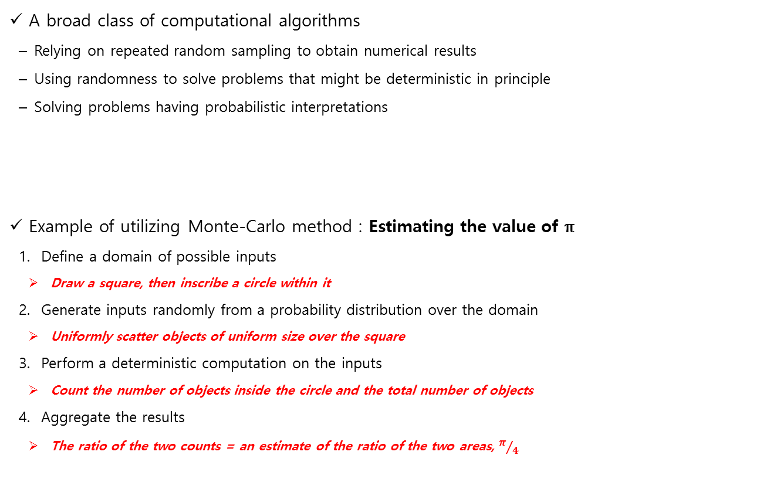
Monte-Carlo method
A broad class of computational algorithms
Relying on repeated random sampling to obtain numerical results
Using randomness to solve problems that might be deterministic in principle
Solving problems having probabilistic interpretations
Example of utilizing Monte-Carlo method : Estimating the value of π
Define a domain of possible inputs
Draw a square, then inscribe a circle within it
Generate inputs randomly from a probability distribution over the domain
Uniformly scatter objects of uniform size over the square
Perform a deterministic computation on the inputs
Count the number of objects inside the circle and the total number of objects
Aggregate the results
The ratio of the two counts = an estimate of the ratio of the two areas, $π/4$
Optimization
Numerical integration
⋯⋯
[ref. https://en.wikipedia.org/wiki/Monte_Carlo_method]

Slide 5
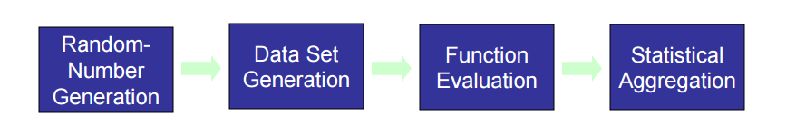
Elements with possible performance improvement through GPU
Typical Monte-Carlo steps
Random number generation → Parallel RNG [ Several algorithms are available]
Data set generation → Data transfer / Memory management / device storage space …
Function Evaluation → Avoid branching / GPU optimized libraries …
Aggregation → Parallel sum-reduction …

Slide 6
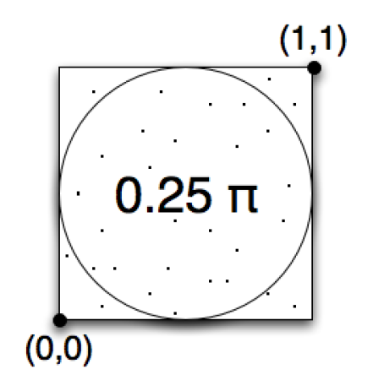
Estimating the value of 𝛑 with GPU
Monte-Carlo method in CUDA Thrust
CUDA Thrust
: Thrust is a C++ template library for CUDA based on the Standard Template Library (STL). Thrust allows you to implement high performance parallel applications with minimal programming effort through a high-level interface that is fully interoperable with CUDA C.
[ref. CUDA-Accelerated Monte-Carlo for HPC, Andrew Sheppard]
[ref. http://docs.nvidia.com/cuda/thrust/#axzz4duRGWVsN]

Slide 7
Estimating the value of 𝛑 with GPU
Monte-Carlo method in CUDA Thrust
CUDA Thrust
: Thrust is a C++ template library for CUDA based on the Standard Template Library (STL). Thrust allows you to implement high performance parallel applications with minimal programming effort through a high-level interface that is fully interoperable with CUDA C.
[ref. CUDA-Accelerated Monte-Carlo for HPC, Andrew Sheppard]
[ref. http://docs.nvidia.com/cuda/thrust/#axzz4duRGWVsN]

Slide 8
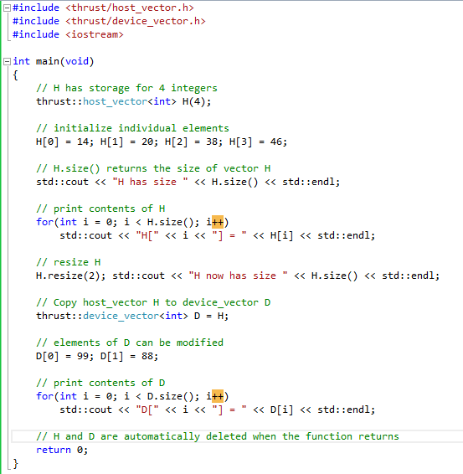
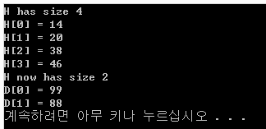
Estimating the value of 𝛑 with GPU
Example with CUDA thrust and some features
Thrust takes care of many things behind the scene ( cudaMalloc, cudaFree, etc)
Resizing dynamically
[ref. http://docs.nvidia.com/cuda/thrust/#axzz4duRGWVsN]

Slide 9
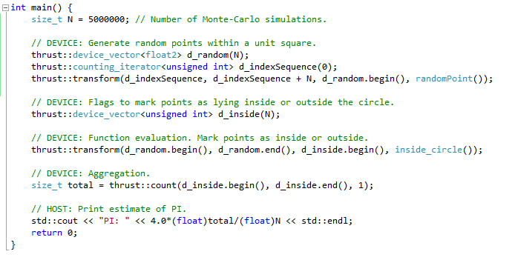
Estimating the value of 𝛑 with GPU
Program and corresponding steps in Monte-Carlo method
Random number generation
Data set generation
Function evaluation
Aggregation

Slide 10
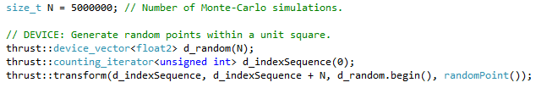
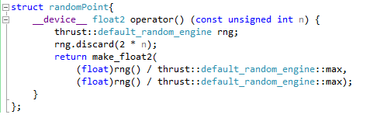
Estimating the value of 𝛑 with GPU
Step 1 & 2. Random number generation / Data set generation
1. Random numbers are generated in parallel on the GPU
2. Data is stored on the GPU directly

Slide 11

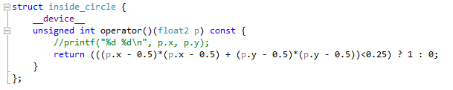
Estimating the value of 𝛑 with GPU
Step 3. Function evaluation
1. Function evaluation is done on the GPU in parallel
2. Work can be done on the simulation data in-situ since the data was generated and stored on the GPU directly

Slide 12

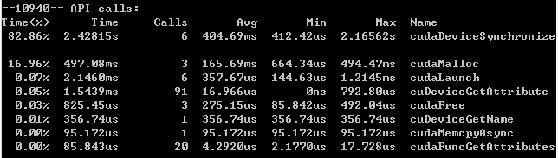
Estimating the value of 𝛑 with GPU
Step 4. Aggregation
1. Aggregation is done in parallel
2. Data has been kept on the device throughout and only the final result is transferred back to the host
The more simulation iteration is done, The more accurate the estimation is
Number of iterations | Estimation of pi
N = 500 | 3.08
N = 5000 | 3.10
N = 50000 | 3.13
N = 5000000 | 3.14

Slide 13


